Slide 1
DSO Overview Training
We have included PPT slides of a DSO Overview Training that can be given to student leaders, new students, staff and faculty. You will need to adjust it slightly depending on your audience. In the note section of the slides, you will find more specific guidelines on how to use the slides to meet your needs.
Notes:
Notes to the DSP:
This presentation can be used for in-coming students, student leaders or faculty. We recommend that you customize it depending on your audience.
Use the Institution's PPT template
Depending on the length of time you have, you should adjust it to be detailed.
Avoid lots of text, avoid flashy transitions, make sure to add alt-tags to all images.

Slide 2
Ability/Disability
Overview Presentation
[date]
[presenter name and role]
Notes:
Notes to the DSP:
This presentation can be used for in-coming students, student leaders or faculty. We recommend that you customize it depending on your audience.
Use the Institution's PPT template
Depending on the length of time you have, you should adjust it to be detailed.
Avoid lots of text, avoid flashy transitions, make sure to add alt-tags to all images.

Slide 3
[DSO Name]
[Summary of what the office does]
[Quick reference to the laws]
                Institutions receiving federal funds must ensure students with disabilities are provided equal access. Relevant anti-discrimination laws:
      Americans with Disabilities Act as Amended (2008) - ADAAA
  Section 504 of the Rehabilitation Act of 1973
[Summary of who they serve]
Notes:
Notes to the DSP:
Keep the overview to 2 o 3 bullets, remember your audience.
Share what percentage of the student body you currently support and/or the different types of disabilities that your office serves.

Slide 4
The Accommodation Process
[Step 1]
[Step 2]
[Step 3]
Notes:
Notes to the DSP:
Outline the accommodation process with numerical bullets.
Provide links to forms that students might need to fill out.
Detail your documentation requirements.

Slide 5
[DSO Name]
[DSO] logistical information:
  [Key dates to be aware of for accommodation requests]
  [Contact information]
  [Location on campus]

Slide 6
[DSO] Staff
[Insert pictures of the DSO staff]

Slide 7
Group Exercise
Notes:
Notes to the DSP:
We recommend pausing here and doing some type of exercise. Suggestions include:
Ask them to answer poll questions related to disability trivia.
Ask them to work with a partner and a campus map to identify the most accessible route to the dinning hall.
Pause and ask them to take a learning style survey.

Slide 8
Accommodations & Universal Design
Accommodations provide equal access; they are not an advantage or special treatment
Universal Design: design and composition of environment can be accessed, understood and used to greatest extent possible by all people regardless of age, size, ability or disability
Notes:
Note to a DSP:
This slide is designed for student leaders, staff or faculty.

Slide 9
Universal Design
Notes:
Notes to a DSP:
This slide is designed for student leaders, staff or faculty.
Add in pictures of examples of UD around your campus. Curb cuts, braille signage, captioning on TVs in the student center, etc. Walk through each and ask the audience to explain it’s broader application.

Slide 10
Disability and Identity
SWD at [Institution]? Approximately [percentage of SWD at the institution]
What influences ability/disability identity?
  Multiple identities
  Comorbid conditions
  Age of onset
  Resources and impact
  Community support
Notes:
Notes to the DSP:
It is important to discuss the intersectionality of disability and diversity. There are several ways to do that, these are just a few suggestions.
Do an accessibility awareness checklist.
Watch Stella Young’s TED talk “I’m not your inspiration, thank you very much”
Discuss invisible verses visible disabilities, validate invisible as much as visible.
Have a conversation around person-first verses disability first language.

Slide 11
Etiquette
Eye-level dialogue
Always ask if 1) a person wants assistance and 2) how to provide it
When using an interpreter, face and speak to the student
When using a sight guide, face and speak to the student
Confidentiality
Notes:
Note to the DSP:
Have a discussion on general disability etiquette. Make sure to note that this is not an exhaustive list.

Slide 12
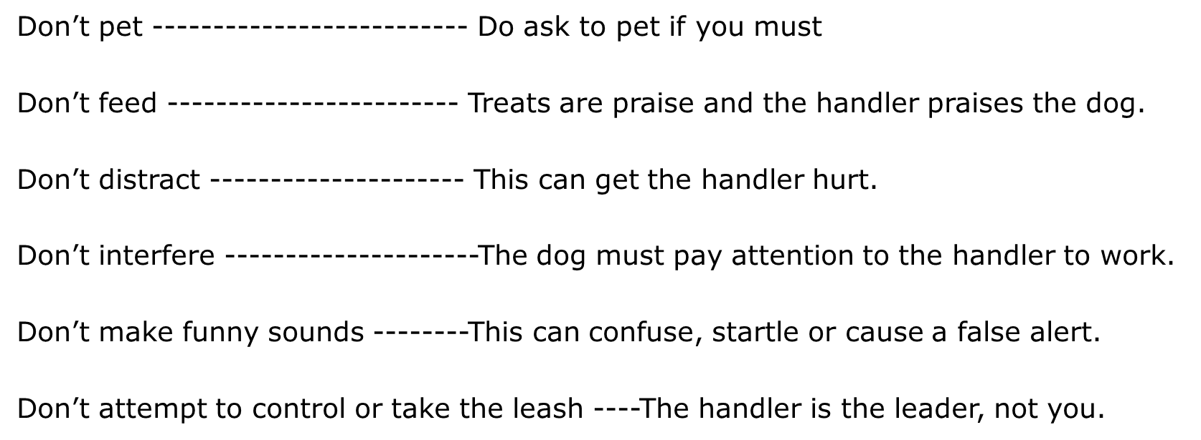
Service Animal Etiquette
The dog is working (even when laying down!)
Notes:
Notes to DSP:
Briefly discuss the differences between and Emotional Assistance Animal and a Service Animal. Focus on the fact that Service Animals may go with the student to class and around campus. Put in a caveat that those with questions should call the DSO.

Slide 13
So, how can I support access and persons with disabilities?
Notes:
Note to DSPs:
Pause and ask your audience to share their thoughts after your presentation thus far.

Slide 14
Considering Physical Access
Take note of access to doors, elevators, call buttons, hallways, ramps
Keep pathways clear of obstructions
Report elevators, touch pads, and call buttons that aren’t working, burned out or flickering lights
Grab-and-go items like brochures, business cards, and personal use items like Kleenex, hand sanitizer should all be visible and accessible from a seated position
Notes:
Note to DSPs:
Personalize this slide to meet the needs of your institution.

Slide 15
Planning Accessible Events
Physical space
Food at events (consider food allergies and dietary restrictions)
Include an accommodation statement in your advertisements
Recognize accessible emergency exits
Be sensitive to chemical smells (consider “no scent events”)
Accessible event materials
Notes:
Note to DSPs:
Customize an Accessibility Checklist and share it here.

Slide 16
Getting Involved
Student organizations [List those on your campus]
Community events [Highlight upcoming events that include access]
Volunteer opportunities [List those on your campus]
Attend DSO events [Highlight upcoming events]
Join conversations about access and disability as diversity
Notes:
Note for DSPs:
Plug involvement in larger campus organizations or initiatives.

Slide 17
Questions?

